Slide 1
SyriaTel Customer Churn
A Data-Driven Analysis for Strategic Intervention

Slide 2
Table of contents
Methodology
Introduction
1
2
Results
Business Recommendations
3
4
Overview and Business Understanding
Data summary, Data Cleaning, Feature Engineering, Tools
Trends, Statistics and Key Insights
Churn risk identification and retention strategies.

Slide 3
1
INTRODUCTION

Slide 4
Project Overview
Objective: Develop a machine learning classification model that predicts whether a customer will churn, enabling SyriaTel to take proactive actions that reduce churn and improve profitability.
Data: SyriaTel Customer Churn Dataset on Kaggle
Audience:
SyriaTel Management
Customer Retention Team

Slide 5
Business Understanding
Stakeholder Need: Understand and reduce customer churn by identifying high-risk customers and implementing targeted retention strategies.
Business Questions:
Which customer segments are most likely to churn?
What behavioral, service, or account factors contribute most to churn?
How can SyriaTel effectively intervene to retain high-risk customers?
Success Outcome: An evidence-based customer retention strategy that reduces churn and improves customer lifetime value.

Slide 6
2
METHODOLOGY

Slide 7
Data Source
The dataset used in this analysis is sourced from the SyriaTel Customer Churn Dataset on Kaggle.
It contains information on 3,333 customers of SyriaTel, a telecommunications company.
The dataset is structured for a binary classification problem, with the target variable churn indicating whether a customer left the company (True/False).
The dataset captures customer account details, usage behavior (calls, minutes, charges), and interactions with customer service.

Slide 8
Data Summary
3,333 customers with 21 attributes: demographics, account info, usage, and churn.
Average usage: 101-day accounts, ~100 calls/day period, 180–200 minutes/day.
International usage: low (10 minutes, 4–5 calls).
Customer service calls: 1.6 on average, up to 9.
Plans: ~90% no international plan, ~72% no voicemail plan.
Coverage: 51 U.S. states; phone numbers unique (not predictive).
Churn: 14.5% churned, 85.5% active.
Data quality: no missing values or duplicates – ready for modeling.

Slide 9
Data Cleaning
Data Cleaning: Dropped non-predictive columns, standardized categories, and checked data types.
Key Analysis Fields: Customer usage, subscription plans, service calls, and churn; created categorical labels for churn and area code.
Outlier Handling: Retained extreme values to preserve meaningful customer behavior patterns.

Slide 10
Modeling
Encoded categorical variables:
Binary: churn, international plan, voicemail plan
Non-binary: State, Area code (one-hot encoded)
Addressed multicollinearity by creating two datasets:
Removed engineered/multicollinear features
Models trained: Logistic Regression, Decision Tree, Random Forest, XGBoost
Key metrics: F1 Score & Precision prioritized for operational relevance

Slide 11
Tools
Python
Pandas & Numpy
Seaborn & Matplotlib
Scikit Learn
Modeling
Core Programming Language
Numerical Analysis & Data processing
Jupyter Notebook
Interactive analysis and Documentation
Visualization

Slide 12
3
RESULTS

Slide 13
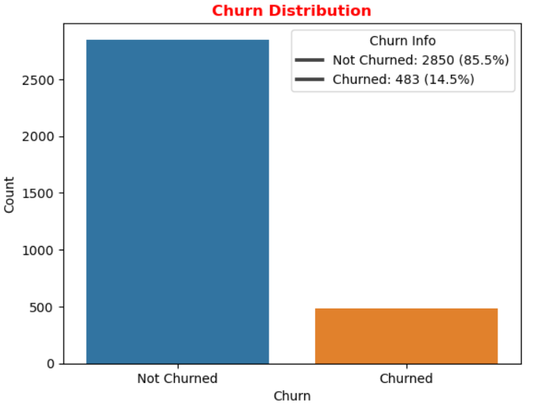
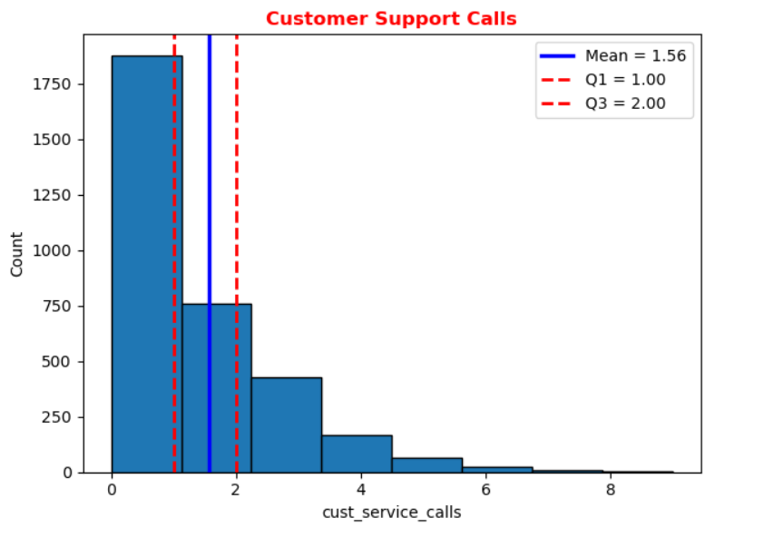
Churn and Service Calls
Target variable imbalance: 85% did not churn, 14.5% churned.
Majority of customers (over two-thirds) did not make any customer support calls.
Customers who contacted support averaged 1 call, with a maximum of 8 calls; distribution is left-skewed.

Slide 14
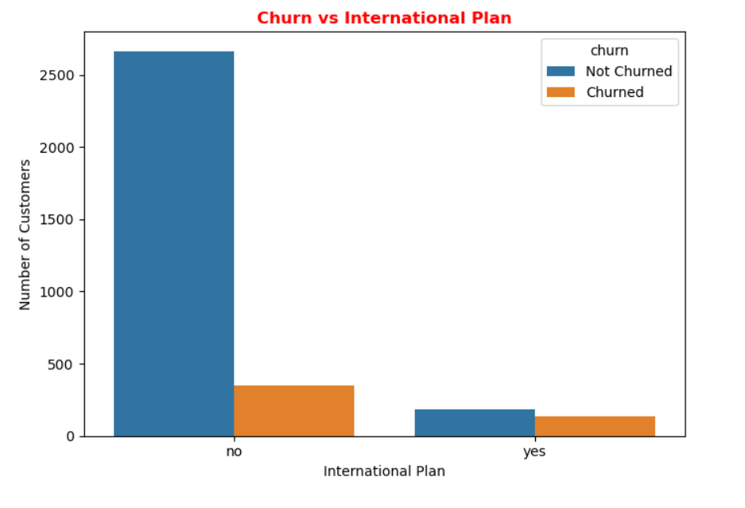
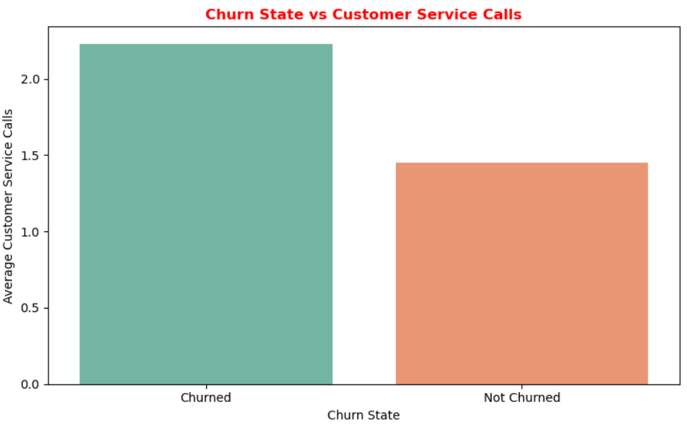
International Plan and Service Calls
Customers with an international plan show higher churn, indicating a greater service expectation.
Customers who churned made more customer service calls on average than those who did not. Frequent support interactions may indicate unresolved issues or dissatisfaction, potentially driving churn

Slide 15
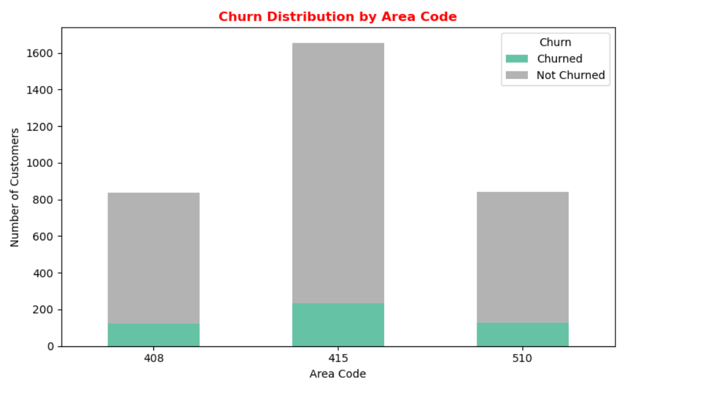
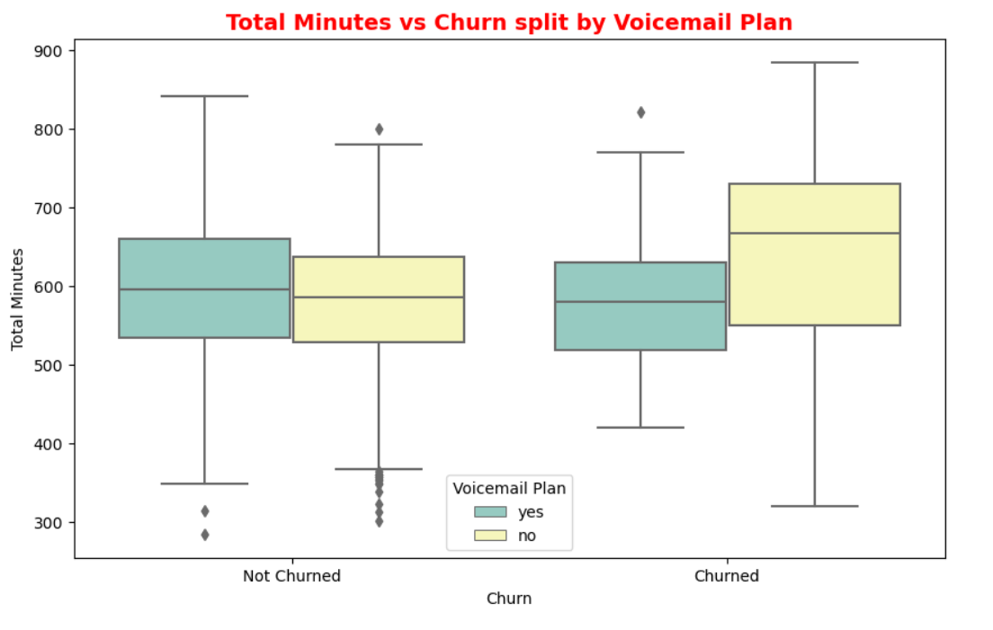
Area Code and Voice Mail Plan
Area code 415 has the highest customer count and a notably larger churn rate, indicating potential service quality or satisfaction issues in this region.
Churned customers without a voicemail plan show higher variability and more outliers in usage, suggesting dissatisfaction among heavy users. Non-churned customers with a voicemail plan have more consistent usage, indicating that voicemail access may support retention.

Slide 16
Model Performance
Without handling multicollinearity:
XGBoost best F1: 88.99%, Precision: 100%
Tree-based models show strong performance; Logistic Regression weaker (F1: 36.46%)
After removing multicollinearity:
XGBoost F1: 80.18%, Precision: 88.12%
Random Forest Precision: 90.14%
Class imbalance addressed with SMOTE:
XGBoost F1: 78.76%, Precision: 84.76%
Random Forest F1: 59.30%, Precision: 75.64%
Cross-validation confirms XGBoost as best trade-off for capturing churners while minimizing false positives

Slide 17
Final XGBoost Model
Final XGBoost performance:
Accuracy: 93.88%, Churn F1-score: 0.77, Churn Precision: 0.82
Top features driving churn:
Area Code
Voice Mail Plan –
Customer Service Calls
International Plan

Slide 18
4
RECOMMENDATIONS

Slide 19
Focus Retention on At-Risk Segments
Identify customers with International Plans and frequent customer support calls.
Offer proactive outreach, loyalty rewards, or usage-based incentives to these high-risk groups.

Slide 20
Improve Quality of Service and Billing
Optimize customer service to reduce repeat or unresolved support calls.
Implement flatrate billing for heavy users to prevent unexpected high charges.

Slide 21
Leverage Plan Features to Reduce Churn
Encourage adoption of voicemail plans for high-usage customers.
Offer customized international or bundled plans for heavy international callers.
Educate customers on plan benefits to highlight convenience, predictability, and cost savings.

Slide 22
Regional Retention Strategies
Investigate and resolve service or infrastructure issues in area code 415 with high churn.
Deploy localized promotions and faster issue resolution to strengthen loyalty in at-risk states.

Slide 23
THANK YOU
Prepared by: KIPROP BRIAN
Email: brian.kibor@student.moringaschool.com
Questions? I'm available for walkthroughs or further data analysis sessions.

